Slide 1


A GAVIN HENDERSON PRODUCTION
PUMA
PERTH ROAD
Notes:
Games Development Module
Gavin Henderson
Puma of Perth Road

Slide 2

Introduction
This video will outline:
Game concept/mechanics
Genre
Target audience
Audio and graphics
Technical choices
Ethical issues
Notes:
In this video I will dicuss choices that I made and why I made them.
I will discuss:
* …

Slide 3
Game Concept & Mechanics
Wolf of Wall Street parody
Protagonist: Jordan Belfort
Money hungry
Dishonest, liar and cheat
Aim: Make as much money as possible
Process
Manually (stock trading)
Automation by getting staff
’upgrade’ staff
Risky investments
Cheating
Game Mechanics:
Day by Day
Pay off debt + mortgage
Business control (pay staff less)
Real consequences
Decisions will be made throughout the game with consequences that will stay through the whole game
Manual stock trading
Can be upgraded to get tips
Automation
Employing staff
Corruption
Insider trading

Slide 4
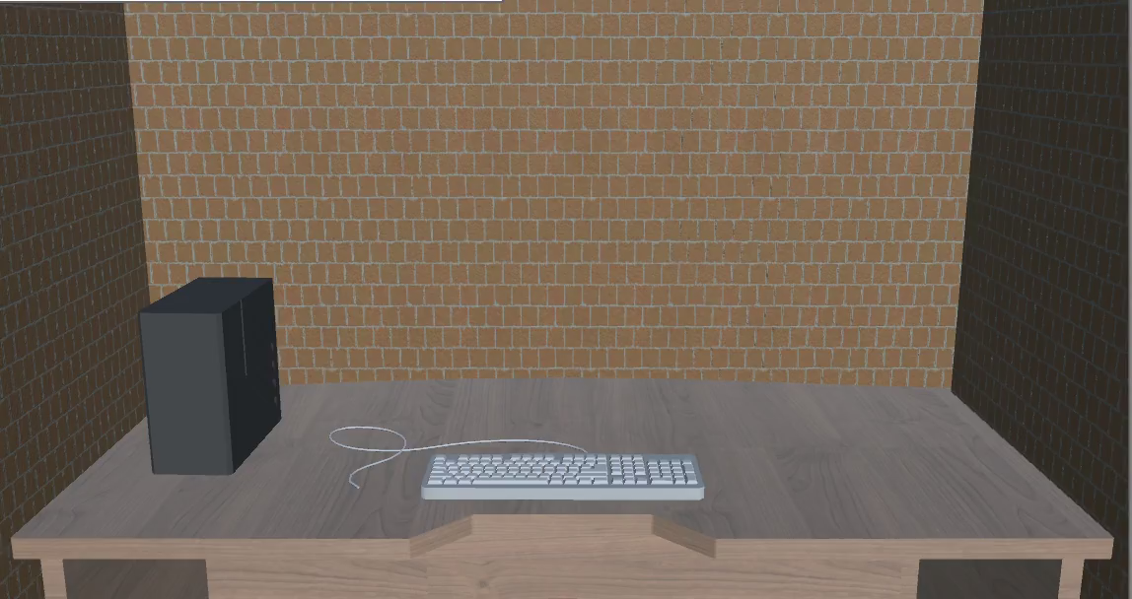
Game Prototype

Slide 5
Unique Selling Points
Simple but effective stock stock trading system
People enjoy playing the risk
Not complex enough to confuse
An outrageous protagonist who lives a ‘thrilling’ life
’Day’ system forcing players to make difficult decisions with real consequences
High pressure that people wouldn’t usually experiance

Slide 6
Game Genre
Aspects of:
Idle game (cookie clicker)
Linear
Story Based
Strategy

Slide 7
Target Audience & Platform
Age: 18 – 40
Explicit content
Lots to for the player to keep tabs on
Casual Gamer
Short time players
Initially Desktop
Allows to add platforms in the feature but keeping initial implementation simple
Controller support can be added
Game is a good fit for browsers and handhelds for future deployment
Notes:
Gamers who play games but are looking for something not reaction based
Gamers who are looking to pick up a game for lots of short sessions

Slide 8

Graphics and Audio
3D graphics
Unity Asset Store
Allowed as long as they are unmodified
Realistic but limited
2D graphics
Simple UI elements
Color scheme of movie
Unity provides UI elements
Audio
Office background noise/music
Source currently unknown but will be royalty free
Voices will be recorded by people I know

Slide 9



Hardware & Software Decisions
Written in C#
Using the Unity Editor
Visual Studio for C# scripts
Autodesk Maya 3D used for 3D modelling
Will aim to make it run on low end hardware
Target audience may not have high end

Slide 10
Ethical Considerations
Stealing wolf of wall street IP
Name changed to show parody
Character names are okay as it’s a true story
Not slander as the story is told accurately
Explicit Content
Age ratings
Swearing and drug warnings
Reasonable adjustments
Text size be altered
Text color be altered
Addictive Playing
Warning will be shown after every ‘day’

Slide 11
Thank you for watching and Happy Trading

